Slide 1
Introduction to Trilinos Discretization and Analysis capabilities
Mauro Perego
Sandia National Laboratories
HPSF conference 2025, May 5-8, Chicago, IL
SAND2025-05585C

Slide 2



Discretization and Analysis packages
Utility tools for Automatic differentiation and or graph-based field dependency manager
Mesh tools (generation, storage, adaptation, level-sets)
Discretizations (mostly finite elements, but also finite volume and mesh-free methods)
Time integrators
Analysis tools (sensitivities, numerical optimization, uncertainty quantifications)

Slide 3
Discretization and Analysis packages
Utilities
Automatic differentiation | Sacado | Eric Phipps <etphipp@sandia.gov>
Graph-based field dependency manager | Phalanx | Roger Pawlowski <rppawlo@sandia.gov>
Mesh tools
Mesh data structure | STK | Alan Williams <william@sandia.gov>
Level set tools | Krino | David Noble <drnoble@sandia.gov>
Spatial and temporal discretizations
Particle-based discretization and data transfer | Compadre | Paul Kuberry <pakuber@sandia.gov>
Local finite element discretization | Intrepid2 | Perego Mauro <mperego@sandia.gov> Nathan Roberts <nvrober@sandia.gov>
Time integration | Tempus | Curt Ober <ccober@sandia.gov>
Finite element library | Panzer | Roger Pawlowski <rppawlo@sandia.gov>
Analysis tools
Uncertainty Quantification | Stokhos | Eric Phipps <etphipp@sandia.gov>
Constrained Optimization | ROL | Denis Ridzal <dridzal@sandia.gov>

Slide 4
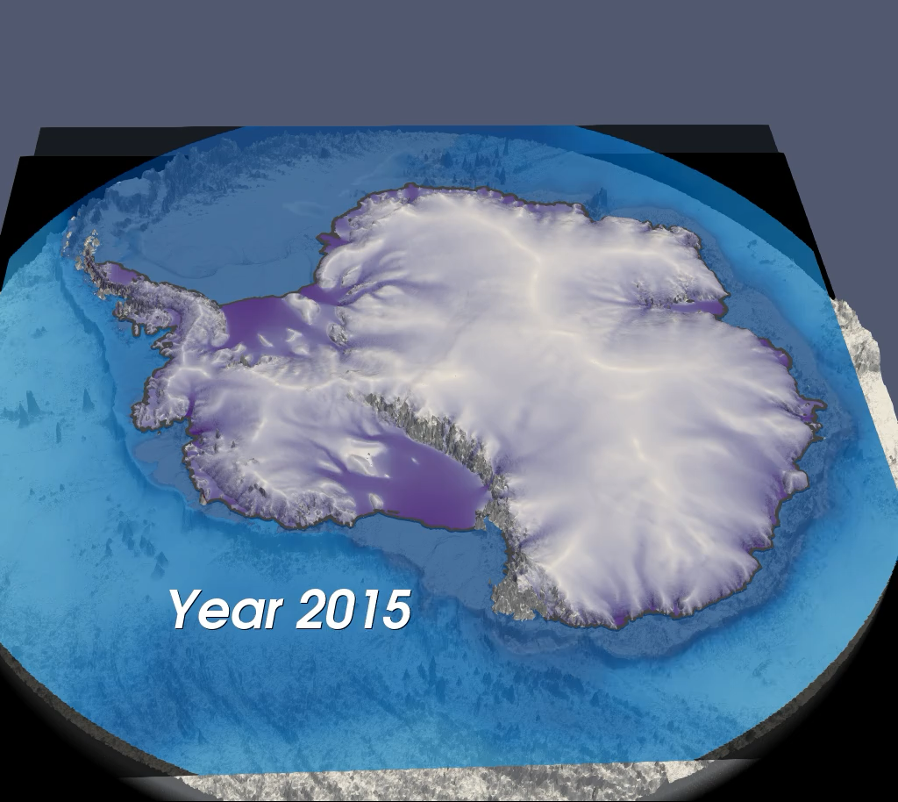
Trilinos showcase vIA ice-Sheet Modeling
Ice-sheet modeling team: L. Bertagna, M. Carlson, K. Liegeois, J. Hu, M. Perego, J. Watkins, A. Salinger, I. Tezaur, R. Tuminaro - Sandia T. Hillebrand, M. Hoffman, S. Price - LANL

Slide 5

Software: MPAS-Albany Land Ice model (MALI)
CAPABILITY | SOFTWARE TOOLS
Finite Elements ice-sheet solver | Albany
Constrained Optimization | ROL
Nonlinear solver | NOX
Time integration | Tempus
Krylov linear solvers/Prec | Belos/MueLu, FROSch
Automatic differentiation | Sacado
Field Dependency manager | Phalanx
Global DoF numbering | Panzer – DoF manager
Mesh data structure | STK
Nodal Finite element | Intrepid2
References: 1. Watkins et al., IJHPCA, 2023 2. Hoffman et al. GMD, 2018
3. Tuminaro, Perego, Tezaur, Salinger, Price, SISC, 2016.
4. Tezaur, Perego, Salinger, Tuminaro, Price, Hoffman, GMD, 2015
5. Perego, Price, Stadler, JGR, 2014

Slide 6
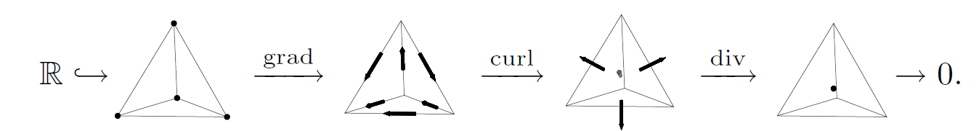
Software: MPAS-Albany Land Ice model (MALI)
CAPABILITY | SOFTWARE TOOLS
Finite Elements ice-sheet solver | Albany
Constrained Optimization | ROL
Nonlinear solver | NOX
Time integration | Tempus
Krylov linear solvers/Prec | Belos/MueLu, FROSch
Automatic differentiation | Sacado
Field Dependency manager | Phalanx
Global DoF numbering | Panzer – DoF manager
Mesh data structure | STK
Nodal Finite element | Intrepid2
Intrepid2 (local discretizations)
High-order FEM bases:
Lagrangian, hierarchical, serendipity
Full De-Rham complex (HGRAD-HCURL-HDIV-HVOL)
Orientation tools for matching DoFs
Mappings between reference and physical elements
Quadrature rules, Cell tools (e.g., inclusion tests)
Projection tools
kernels for integration exploiting structure: Tensor product, Extruded elements, Affine meshes
HGRAD
HCURL
HDIV
HVOL
Phase-field distribution of Vlasov two-stream instability problem: Camellia simulation, courtesy of Nathan Roberts

Slide 7
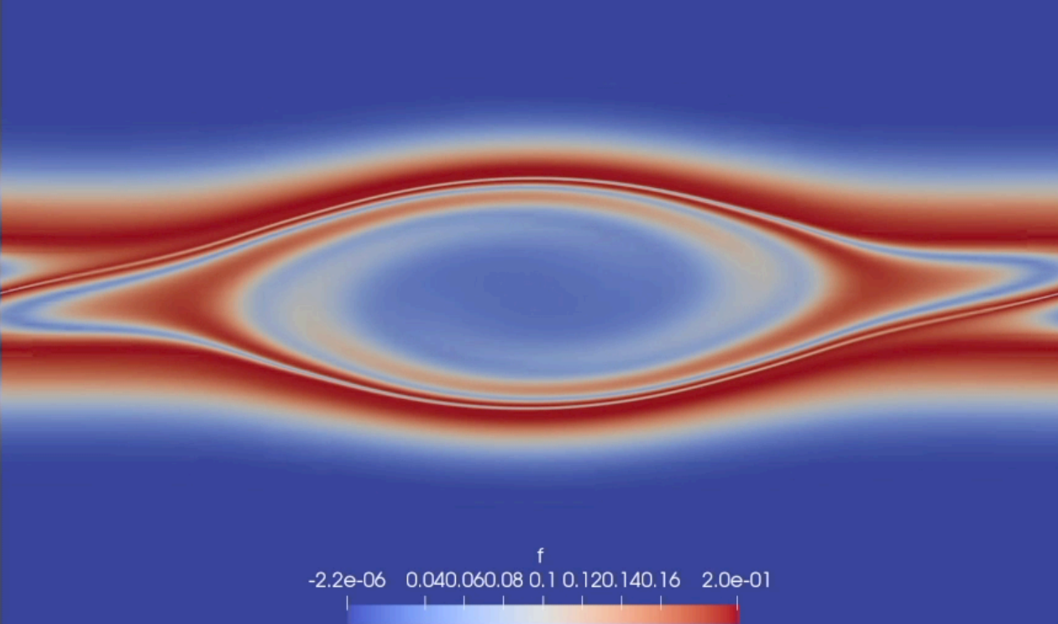
Software: MPAS-Albany Land Ice model (MALI)
CAPABILITY | SOFTWARE TOOLS
Finite Elements ice-sheet solver | Albany
Constrained Optimization | ROL
Nonlinear solver | NOX
Time integration | Tempus
Krylov linear solvers/Prec | Belos/MueLu, FROSch
Automatic differentiation | Sacado
Field Dependency manager | Phalanx
Global DoF numbering | Panzer – DoF manager
Mesh data structure | STK
Nodal Finite element | Intrepid2
Intrepid2 (local discretizations)
High-order FEM bases:
Lagrangian, hierarchical, serendipity
Full De-Rham complex (HGRAD-HCURL-HDIV-HVOL)
Orientation tools for matching DoFs
Mappings between reference and physical elements
Quadrature rules, Cell tools (e.g., inclusion tests)
Projection tools
kernels for integration exploiting structure: Tensor product, Extruded elements, Affine meshes
Applications: MHD, Vlasov, solid mechanics, etc.
Phase-field distribution of Vlasov two-stream instability problem: Camellia simulation, courtesy of Nathan Roberts
Phase-field distribution of Vlasov two-stream instability problem: Camellia simulation, courtesy of Nathan Roberts

Slide 8
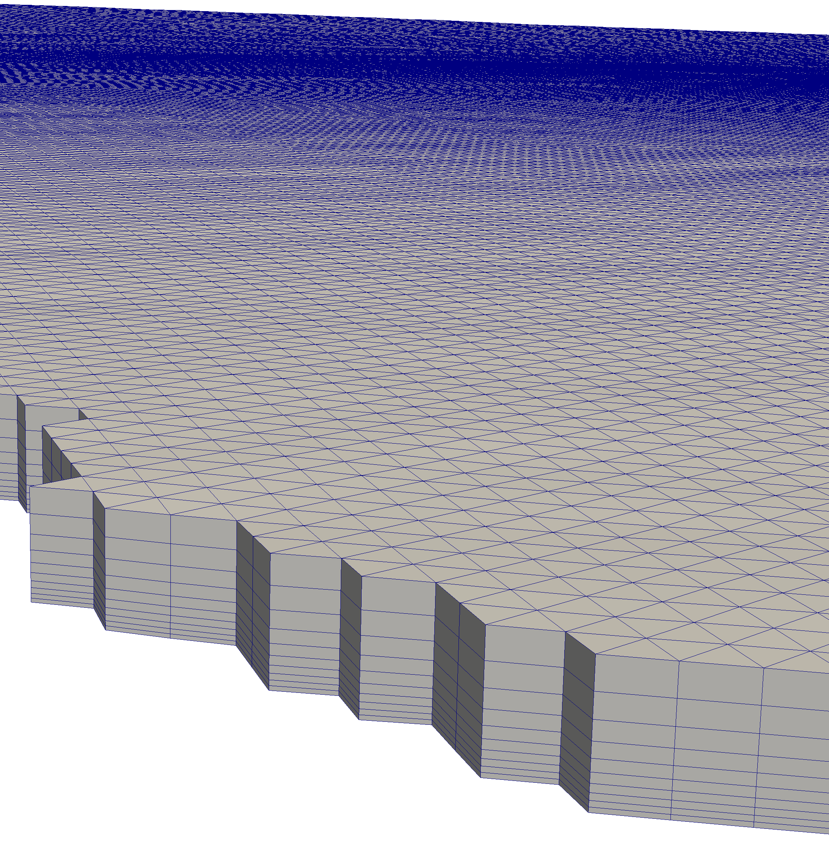
Software: MPAS-Albany Land Ice model (MALI)
CAPABILITY | SOFTWARE TOOLS
Finite Elements ice-sheet solver | Albany
Constrained Optimization | ROL
Nonlinear solver | NOX
Time integration | Tempus
Krylov linear solvers/Prec | Belos/MueLu, FROSch
Automatic differentiation | Sacado
Field Dependency manager | Phalanx
Global DoF numbering | Panzer – DoF manager
Mesh data structure | STK
Nodal Finite element | Intrepid2
STK mesh:
(vertically extruded)
Panzer DoF manager: Global DoF numbered based on local FE DoFs, solution fields and mesh connectivity. Important for Multiphysics problems with nonnodal FE spaces

Slide 9
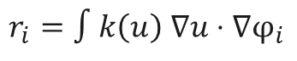
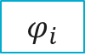
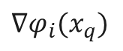

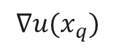
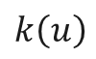
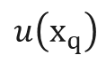
Software: MPAS-Albany Land Ice model (MALI)
CAPABILITY | SOFTWARE TOOLS
Finite Elements ice-sheet solver | Albany
Constrained Optimization | ROL
Nonlinear solver | NOX
Time integration | Tempus
Krylov linear solvers/Prec | Belos/MueLu, FROSch
Automatic differentiation | Sacado
Field Dependency manager | Phalanx
Global DoF numbering | Panzer – DoF manager
Mesh data structure | STK
Nodal Finite element | Intrepid2
Phalanx* Field Dependency manager
$$r_{i}=∫k\left(u\right) ∇u⋅∇φ_{i}$$
$$k\left(u\right)$$
$$∇u(x_{q})$$
evaluators
$$u\left(x_{q}\right)$$
$∇φ_{i}(x_{q})$
$$u_{i}$$
$$φ_{i}$$
dof values
Direct Acyclic Graph (DAG) of dependencies
*Notz, Pawlowski and Sutherland; ACM Trans. Math., 2012

Slide 10
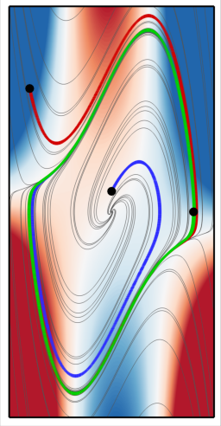
Software: MPAS-Albany Land Ice model (MALI)
CAPABILITY | SOFTWARE TOOLS
Finite Elements ice-sheet solver | Albany
Constrained Optimization | ROL
Nonlinear solver | NOX
Time integration | Tempus
Krylov linear solvers/Prec | Belos/MueLu, FROSch
Automatic differentiation | Sacado
Field Dependency manager | Phalanx
Global DoF numbering | Panzer – DoF manager
Mesh data structure | STK
Nodal Finite element | Intrepid2
Tempus, Time integration
Many explicit and implicit steppers: BDF, RK, IMEX, Leapfrog, …
Adaptive time-stepping
(Adjoint) sensitivity analysis
Interfaces with NOX/ROL
Courtesy of C. Ober

Slide 11
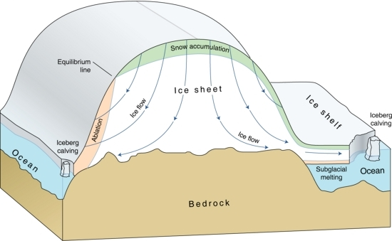
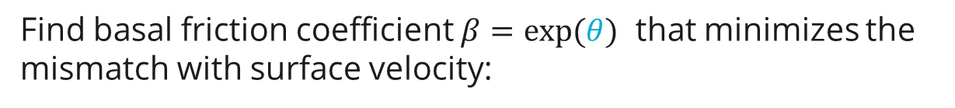
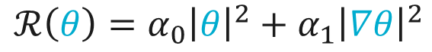
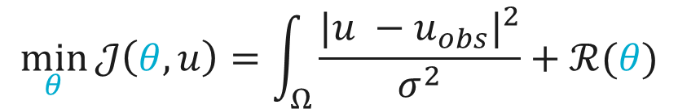
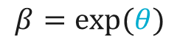

Ice-sheet model calibration - deterministic
Goal: Find the initial/present-day thermo-mechanical state of the ice sheet and estimate the unknown/poorly known model parameters, by matching observations
Approach: PDE-constrained optimization
Find basal friction coefficient $β=exp(θ)$ that minimizes the mismatch with surface velocity:
$$\min_{θ}{𝒥\left(θ,u\right)=\int_{Ω}{\frac{{|u −u_{obs}|}^{2}}{σ^{2}}}+ℛ(θ)}$$
Subject to the coupled ice flow problem (constraint). The constraint maps $θ→u(θ)$.
unknown sliding parameter
$$β=exp⁡(θ)$$
Typical regularization term:
$$ℛ\left(θ\right)={α_{0}{\left|θ\right|}^{2}+α_{1}\left|∇θ\right|}^{2}$$

Slide 12
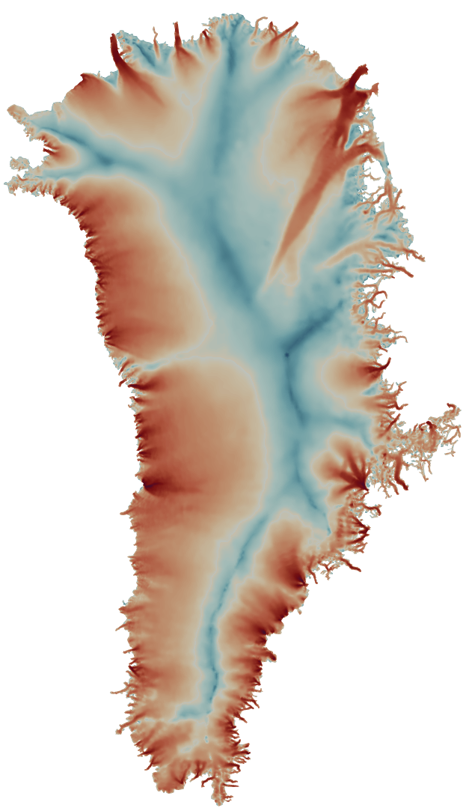
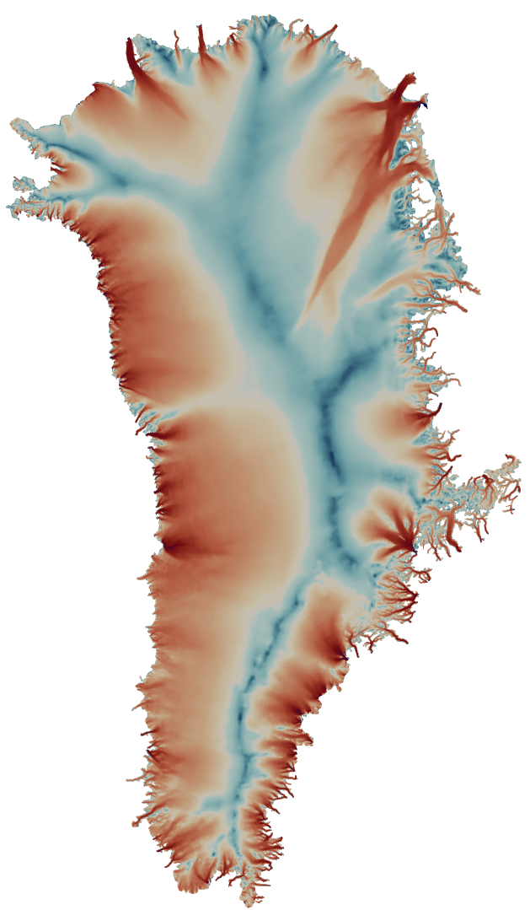
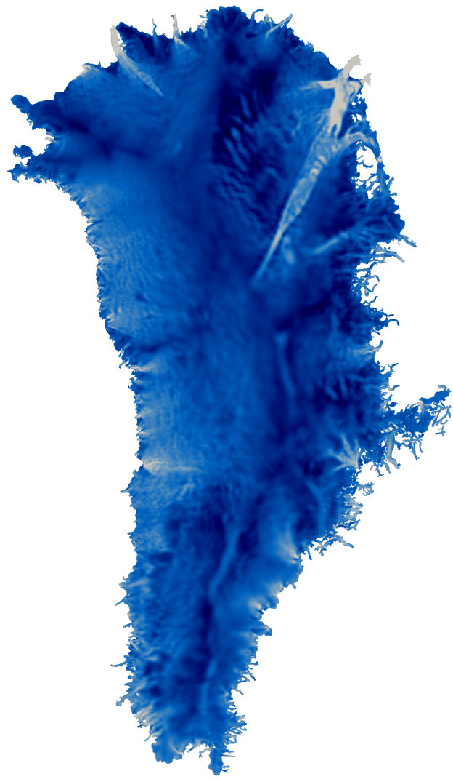
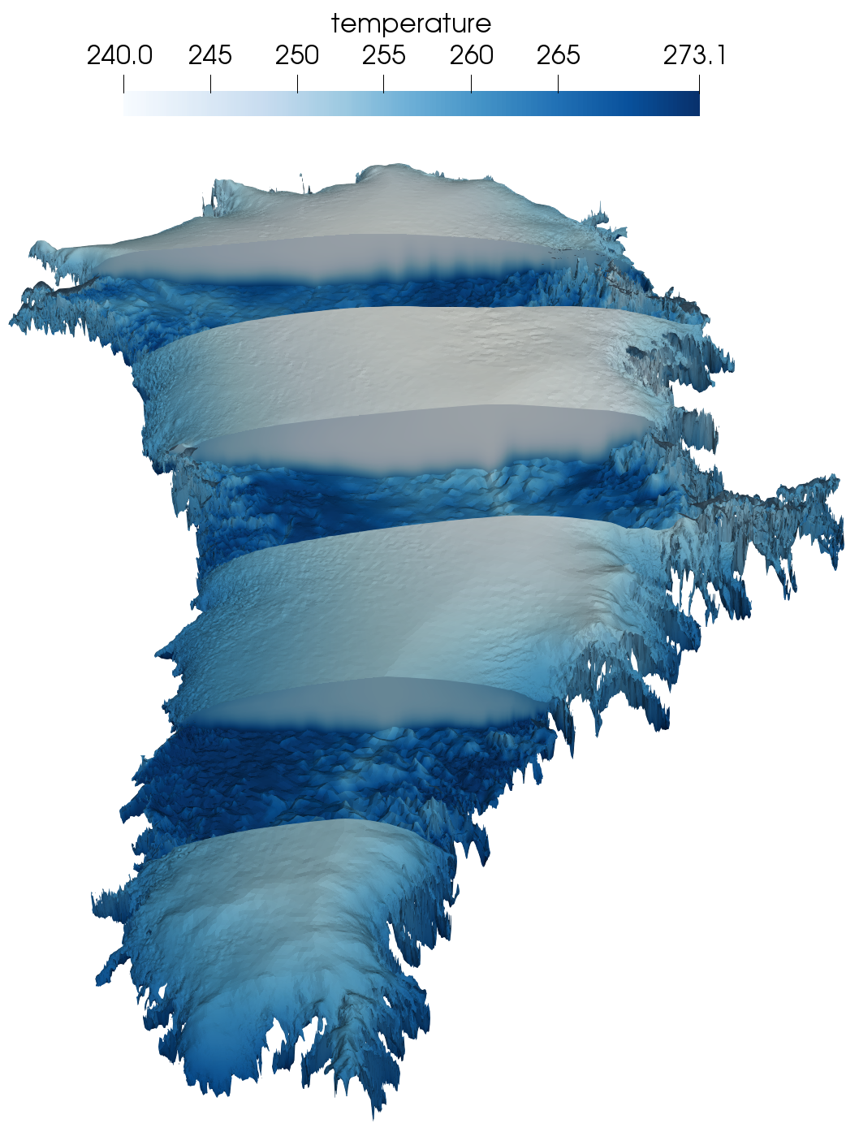
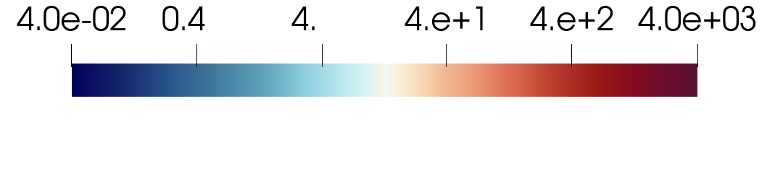
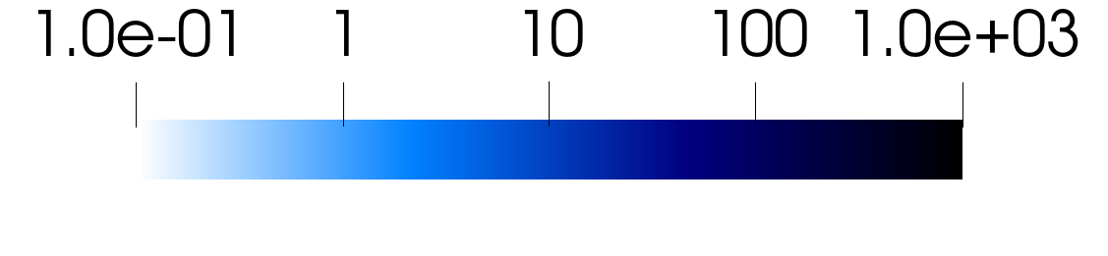
Thermo-mechanical calibration of Greenland ice sheet
modeled ice speed [m/yr]
observed ice speed [m/yr]
modeled basal friction [kPa yr/m]
modeled temperature [K]
Variable resolution 1-10km mesh, 300K parameters, 14M unknowns.
The optimization is constrained by the coupled velocity-temperature solvers. As a byproduct of the optimization we get an initial temperature field that is consistent with the velocity.

Slide 13

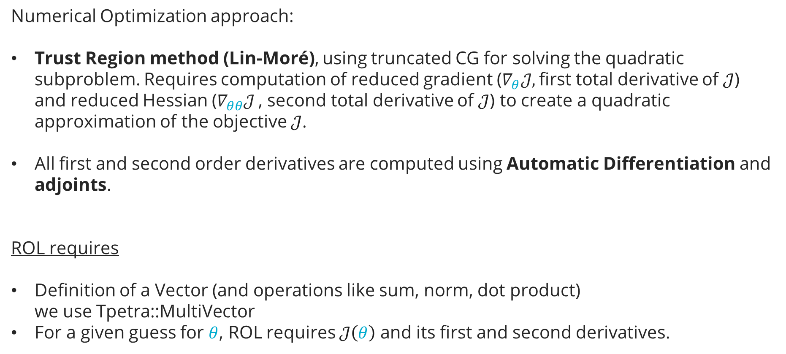
Ice-sheet model calibration
Numerical Optimization approach:
Trust Region method (Lin-Moré), using truncated CG for solving the quadratic subproblem. Requires computation of reduced gradient ($∇_{θ}𝒥,$first total derivative of $𝒥$) and reduced Hessian ($∇_{θθ}𝒥^{ }$, second total derivative of $𝒥$) to create a quadratic approximation of the objective $𝒥$.
All first and second order derivatives are computed using Automatic Differentiation and adjoints.
ROL requires
Definition of a Vector (and operations like sum, norm, dot product) we use Tpetra::MultiVector
For a given guess for $θ$, ROL requires $𝒥\left(θ\right)$ and its first and second derivatives.

Slide 14
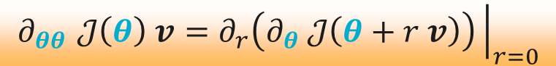
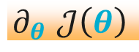
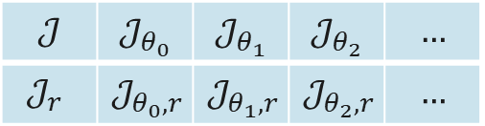
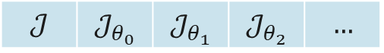
Ice-sheet model calibration – Hessian Computation with AD
PDE-constrained optimization methods benefit from Gradients and Hessian mat-vec products,
computed with Automatic Differentiation (AD) using Sacado package:
Sacado derivative type (value + derivs)
Gradient
$$∂_{θ }𝒥\left(θ\right)$$
$$𝒥$$ | $$𝒥_{θ_{0}}$$ | $$𝒥_{θ_{1}}$$ | $$𝒥_{θ_{2}}$$ | $$…$$
Sacado nested derivatives (2d array)
Hessian
$$∂_{θθ }𝒥\left(θ\right) v=∂_{r}\left(∂_{θ} 𝒥\left(θ+r v\right)\right){\left.​\right|}_{r=0}$$
$$𝒥$$ | $$𝒥_{θ_{0}}$$ | $$𝒥_{θ_{1}}$$ | $$𝒥_{θ_{2}}$$ | $$…$$
$$𝒥_{r}$$ | $$𝒥_{θ_{0},r}$$ | $$𝒥_{θ_{1},r}$$ | $$𝒥_{θ_{2},r}$$ | $$…$$
Sacado provides specializations for Kokkos views to efficiently handle derivative types. Layout of Sacado type can be chosen to effectively use architectures and boost parallelism* *Phipps, Pawlowski and Trott; ACM Transactions on Mathematical Software, 2022

Slide 15

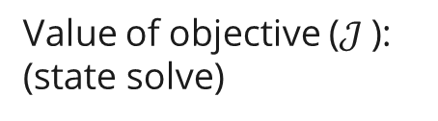
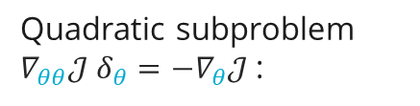
Ice-sheet model calibration: PDE constrained optimization
Optimization loop, O(100) iterations
Value of objective ($𝒥$): (state solve)
Reduced Gradient ($∇_{θ}𝒥$):
Quadratic subproblem $∇_{θθ}𝒥^{ }δ_{θ}=−∇_{θ}𝒥$:
Adjoint solve
Newton loop O(10) iters
Truncated CG loop, O(20) iters
Linear solve
Reduced Hessian vec product:
Adjoint solve 1
Adjoint solve 2
Data from a relatively simple optimization (Humboldt glacier on a coarse mesh):
# state solves: 116
# reduced gradients: 98 # reduced Hessian: 1568
# total linear solves (including adjoints): 3821

Slide 16
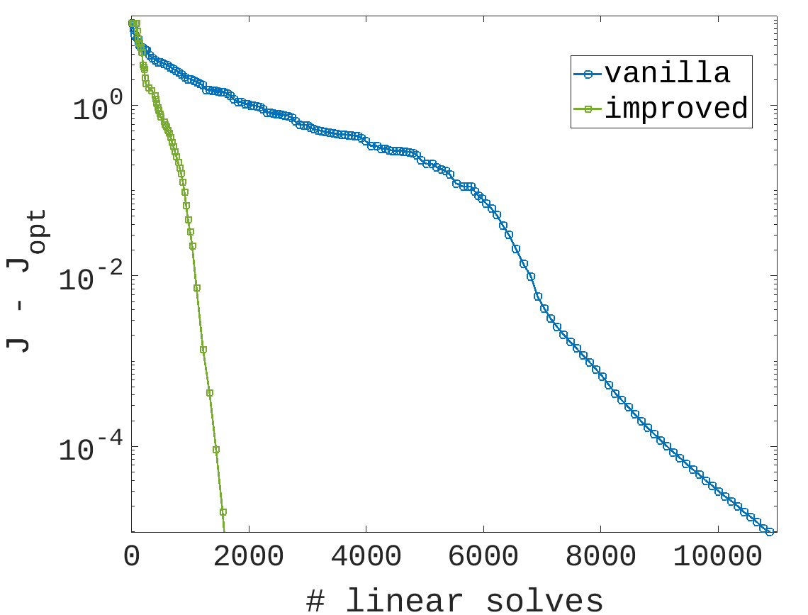
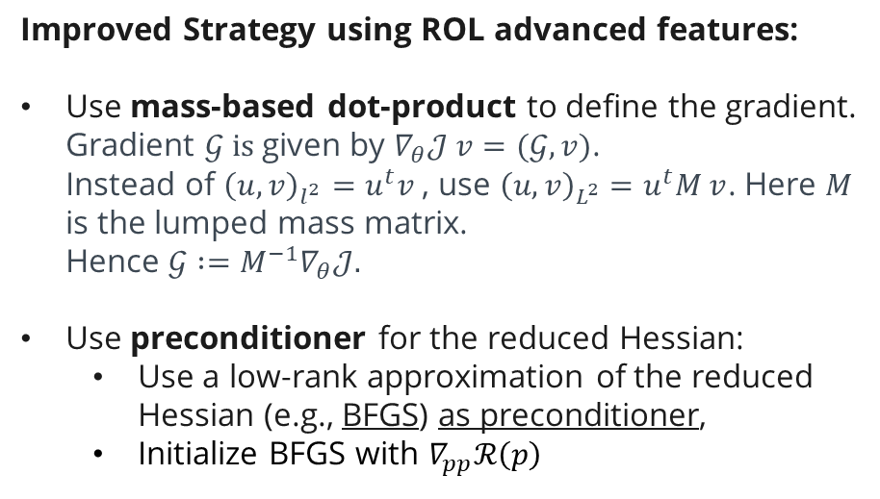
Ice sheet calibration: PDE constrained optimization
Cost is often dominated by evaluation of reduced Hessian (and in particular by the assembly phase)
Improved Strategy using ROL advanced features:
Use mass-based dot-product to define the gradient. Gradient $𝒢 is$ given by $∇_{θ}𝒥 v=(𝒢, v)$. Instead of ${\left(u,v\right)}_{l^{2}}=u^{t}v$ , use ${\left(u,v\right)}_{L^{2}}=u^{t}M^{ }v$. Here $M$ is the lumped mass matrix. Hence ${𝒢 :=M^{−1}∇}_{θ}𝒥.$
Use preconditioner for the reduced Hessian:
Use a low-rank approximation of the reduced Hessian (e.g., BFGS) as preconditioner,
Initialize BFGS with $∇_{pp}ℛ\left(p\right)$
Problem: Optimization to initialize Humboldt glacier Ice velocity depends on friction parameter. Ice temperature held constant.

Slide 17
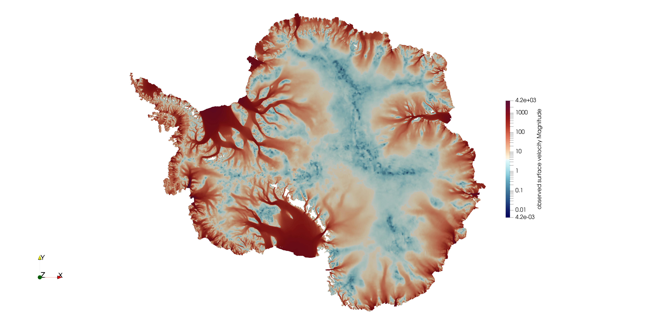
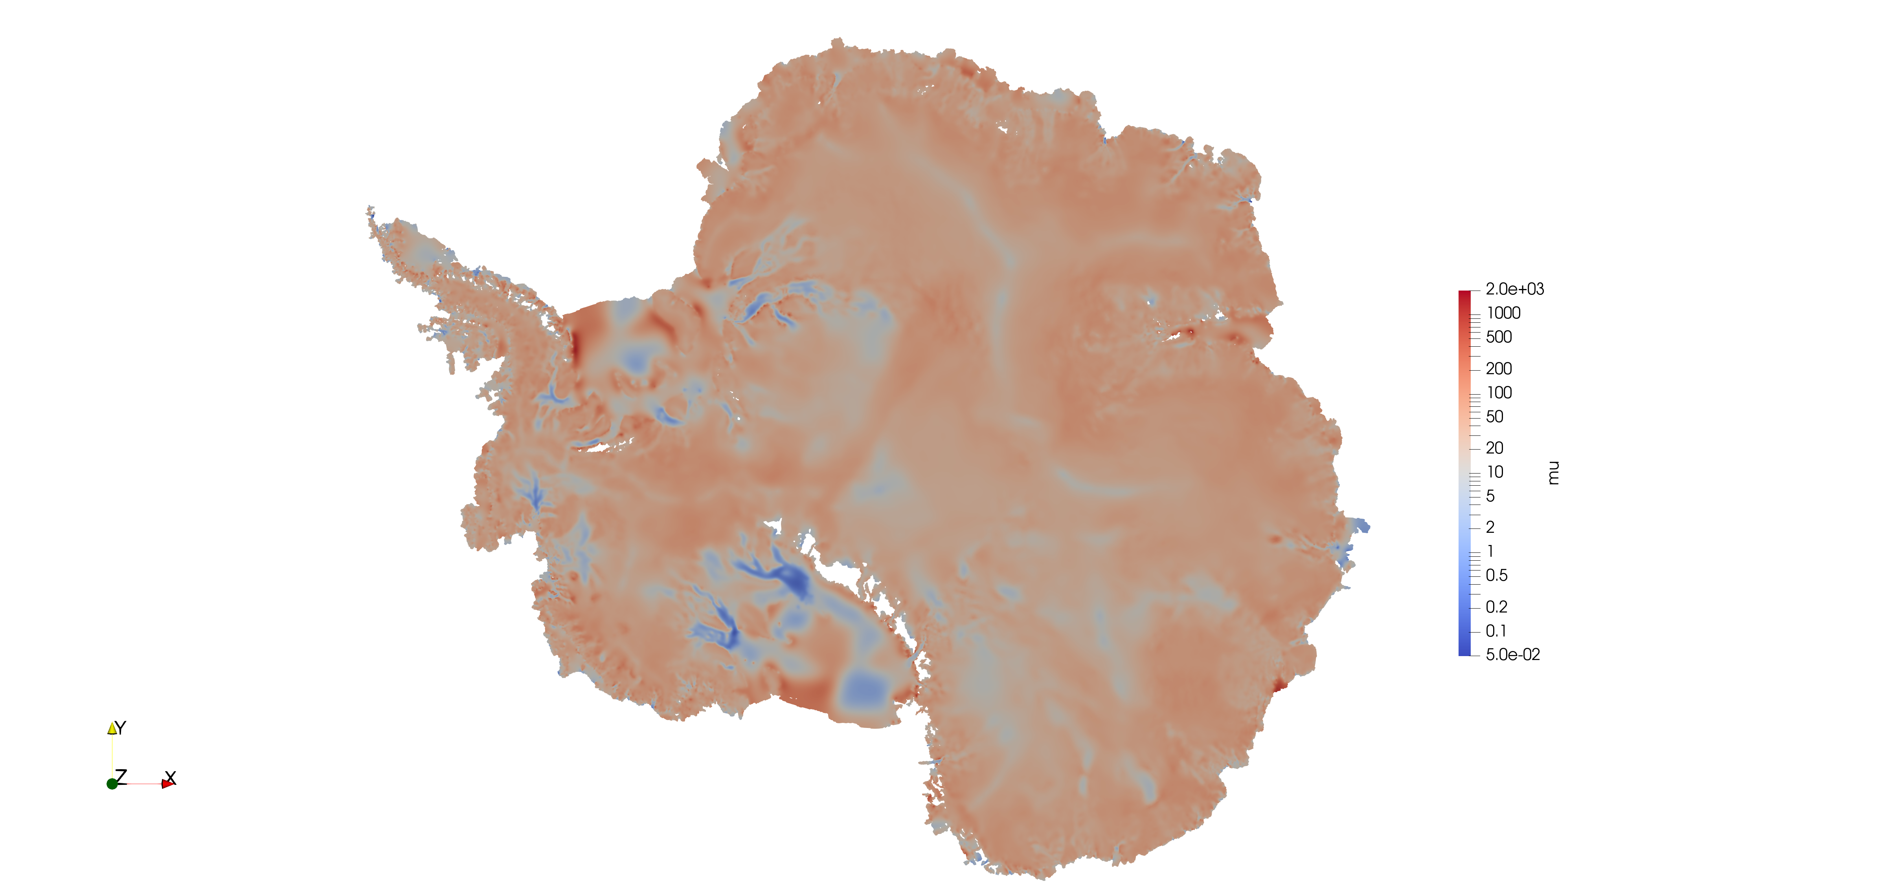

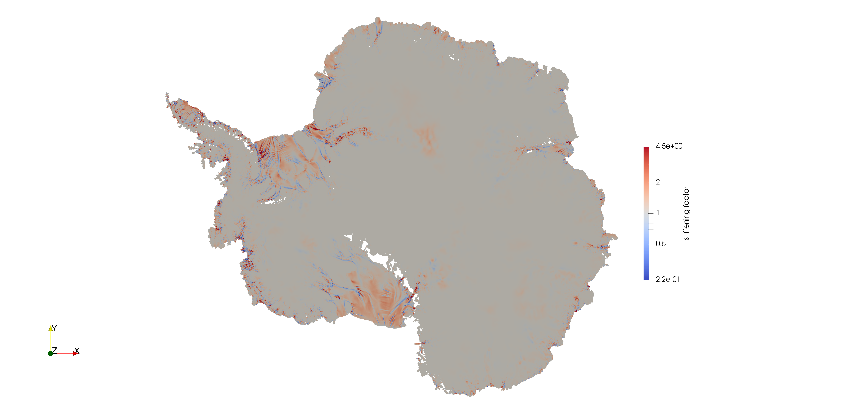
Ice sheet calibration: Antarctic ice sheet
observed ice speed [m/yr]
basal friction
modeled ice speed [m/yr]
Stiffening factor

Slide 18
Ice sheet calibration: PDE constrained optimization
Cost is often dominated by evaluation of reduced Hessian (specifically by the assembly phase)
CPU node
GPU node
Perlmutter architecture
CPU node: 2 AMD Milan (64 cores each) GPU node: 1 AMD Milan + 4 NVIDIA A100
Problem: Optimization to initialize Antarctic glacier Ice velocity depends on friction parameter and stiffening. Ice temperature held constant.

Slide 19

How To USE Trilinos tools in your application

Slide 20
Adopting Trilinos tools in Finite Element applications
Your Case | You can use | Notes
I’d like to add advanced capabilities to my application with not-too-intrusive changes | Intrepid2 w/ Dof Manager, (py)ROL | Approach used by Camellia, Sierra, Plato, .. Easy to interface w/ (py)ROL
I like the Trilinos model evaluator concept and AD. I’m happy to restructure my application. | Intrepid2, Sacado, Phalanx, Tempus (Py)ROL | Approach used by Albany Application in charge of mesh, assembly, solvers.
I love everything Trilinos, I’m starting from scratch. | Panzer | Panzer provides Mesh I/O, space and time discretization, linear and nonlinear solvers, sensitivieties and optimization solvers Drekar, Empire use this approach.

Slide 21






Incomplete list of contributors and sponsor
Contributors: Ross Bartlett, Pavel, Bochev, Brian Carnes, Eric Cyr, Carter Edward, Nathan Ellingwood, Christian Glusa, Kyngjoo Kim, Drew Kouri, Paul Kuberry Kim Liegeois, David Noble, Roger Pawlowski, Mauro Perego, Kara Peterson, Eric Phipps, Curt Ober, Denis Ridzal,
Nathan Roberts, Andy Salinger, Chris Siefert, Irina Tezaur, Greg Von Winckel, Alan Williams
Sponsors:

